Slide 1
Location Decisions

Slide 2
Locating in a linear market
Assume there is a kilometer beach and two ice cream vendors. Market is distributed uniformly. Where do they locate?
Whether the selected location is optimal?
Should govt. intervene in selecting deciding location?

Slide 3
Features
The objective is to maximize the benefit of location to the firm
Increasingly global in nature
Significant impact on fixed and variable costs
Decisions made relatively infrequently
Once committed to a location, many resource and cost issues are difficult to change
Long-term decisions

Slide 4
Location Decisions- Country Selection
Political risks, government rules, attitudes, incentives
Cultural and economic issues
Location of markets
Labor talent, attitudes, productivity, costs
Availability of supplies, communications, energy
Exchange rates and currency risks

Slide 5
Location Decisions- Region Selection
Political risks in a federal structure
Attractiveness of region
Labor availability and costs
Availability of utilities
Environmental regulations
Government incentives and fiscal policies
Proximity to raw materials and customers
Land/construction costs

Slide 6
Location Decisions- Site Selection
Site size and cost
Air, rail, highway, and waterway systems
Zoning restrictions
Proximity of services/ supplies needed
Environmental impact issues

Slide 7
Methods for Location Selection
Factor Rating Model
Locational Break Even Analysis
Center of Gravity Model
Geographic Information System

Slide 8
Factor-Rating Method
Popular because a wide variety of factors can be included in the analysis
Six steps in the method
Develop a list of relevant factors called critical success factors
Assign a weight to each factor
Develop a scale for each factor
Score each location for each factor
Multiply score by weights for each factor for each location
Recommend the location with the highest point score

Slide 9
Factor-Rating Example
Critical Scores
Success (out of 100) Weighted Scores
Factor Weight France Denmark France Denmark
Labor availability and attitude .25 70 60 (.25)(70) = 17.5 (.25)(60) = 15.0
People-to car ratio .05 50 60 (.05)(50) = 2.5 (.05)(60) = 3.0
Per capita income .10 85 80 (.10)(85) = 8.5 (.10)(80) = 8.0
Tax structure .39 75 70 (.39)(75) = 29.3 (.39)(70) = 27.3
Education and health .21 60 70 (.21)(60) = 12.6 (.21)(70) = 14.7
Totals 1.00 70.4 68.0

Slide 10
Locational Break-Even Analysis
Method of cost-volume analysis used for industrial locations
Three steps in the method
Determine fixed and variable costs for each location
Plot the cost for each location
Select location with lowest total cost for expected production volume

Slide 11
Locational Break-Even Analysis Example
Three locations:
Fixed Variable Total
City Cost Cost Cost
Akron $30,000 $75 $180,000
Bowling Green $60,000 $45 $150,000
Chicago $110,000 $25 $160,000
Selling price = $120
Expected volume = 2,000 units
Total Cost = Fixed Cost + Variable Cost x Volume

Slide 12
Locational Break-Even Analysis Example
–
$180,000 –
–
$160,000 –
$150,000 –
–
$130,000 –
–
$110,000 –
–
–
$80,000 –
–
$60,000 –
–
–
$30,000 –
–
$10,000 –
–
Chicago cost curve
Annual cost
Bowling Green cost curve
Akron cost curve
Akron lowest cost
Bowling Green lowest cost
Chicago lowest cost
| | | | | | |
0 500 1,000 1,500 2,000 2,500 3,000
Volume

Slide 13
Center-of-Gravity Method
Finds location of distribution center that minimizes distribution costs
Considers
Location of markets
Volume of goods shipped to those markets
Shipping cost (or distance)

Slide 14
Center-of-Gravity Method
Place existing locations on a coordinate grid
Grid origin and scale is arbitrary
Maintain relative distances
Calculate X and Y coordinates for ‘center of gravity’
Assumes cost is directly proportional to distance and volume shipped

Slide 15
Center-of-Gravity Method
∑d_{ix}Q_{i}
∑Q_{i}
x - coordinate =
i
i
∑d_{iy}Q_{i}
∑Q_{i}
y - coordinate =
i
i
where d_{ix} = x-coordinate of location i
d_{iy} = y-coordinate of location i
Q_{i} = Quantity of goods moved to or from location i

Slide 16
Center-of-Gravity Method
North-South
New York (130, 130)
120 –
90 –
60 –
30 –
–
Chicago (30, 120)
Pittsburgh (90, 110)
Atlanta (60, 40)
| | | | | |
30 60 90 120 150
East-West
Arbitrary origin

Slide 17
Center-of-Gravity Method
Number of Containers
Store Location Shipped per Month
Chicago (30, 120) 2,000
Pittsburgh (90, 110) 1,000
New York (130, 130) 1,000
Atlanta (60, 40) 2,000
(30)(2000) + (90)(1000) + (130)(1000) + (60)(2000)
2000 + 1000 + 1000 + 2000
x-coordinate =
= 66.7
(120)(2000) + (110)(1000) + (130)(1000) + (40)(2000)
2000 + 1000 + 1000 + 2000
y-coordinate =
= 93.3

Slide 18
Center-of-Gravity Method
North-South
New York (130, 130)
120 –
90 –
60 –
30 –
–
Chicago (30, 120)
Pittsburgh (90, 110)
+
Center of gravity (66.7, 93.3)
Atlanta (60, 40)
| | | | | |
30 60 90 120 150
East-West
Arbitrary origin

Slide 19
Geographic Information Systems (GIS)
New tool to help in location analysis
Enables more complex demographic analysis
Available data bases include
Detailed census data
Detailed maps
Utilities
Geographic features
Locations of major services

Slide 20
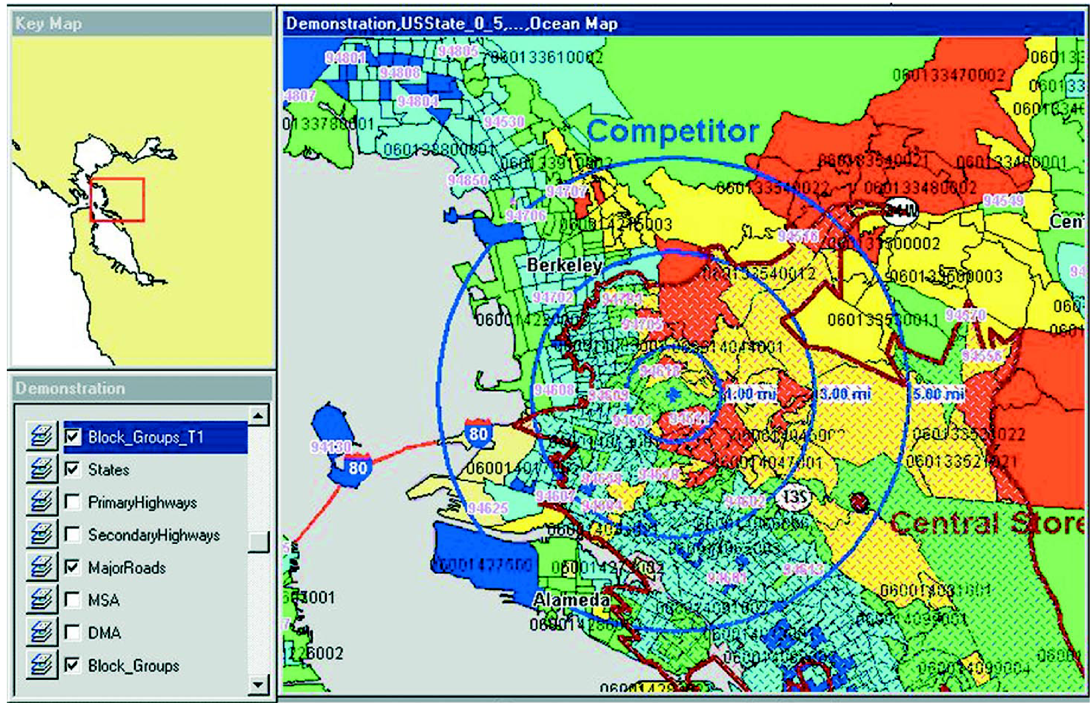
Geographic Information Systems (GIS)

